Slide 1

Automated Test Framework (ATF)
Mike Hedlund
Scott Halverson
goo.gl/hkkwEo
Test Smarter, Not Harder

Slide 2
What Rocks
Native and Easy
Trendy, makes us fit in with the Agile DevOps crowd
Removes the scare factor during upgrades
No extra $$
Speeds up continuous delivery
Rapidly improving capabilities

Slide 3
What Doesn’t Rock
Not yet support for Service Portal
Quirks still getting worked out
Managing versioning of the test configurations
Paradigm shift to having the testing tool be the same tool as what is being tested
Upon new release is the testing tool broke or is it the application it’s testing?
Running automatically when a new “build” is deployed has to be rethought, as their is no concept of a “build” in ServiceNow

Slide 4
Key Components
Step Configs
Form
REST
Server
Service Catalog
Tests
Test Suites
Scheduling

Slide 5
Demo & Lab

Slide 6
Incident Requirement ID | Requirement
IM_001 | The 'ATF is Great' field shall be 'read-only' to all users.
IM_002 | The 'ATF Demo Notes' field shall only be visible when the Category field has a value of 'ATF Demo'.
IM_003 | The 'ATF Demo' button shall only be visible to Users with the 'atf_demo' role.
IM_004 | A new section shall be added to the Incident form named 'ATF Demo'. This section will include the 'ATF is Great', and 'ATF demo notes' fields.
IM_005 | A notification shall be sent to the 'Caller' when an Incident record is created.

Slide 7
ATF Lab - Automated Test Framework Properties
Navigate to the ‘Automated Test Framework’ application from the left Nav.
Under ‘Administration’ select the ‘Properties’ module.
Under Test/Test Suite Properties Change the settings so Tests and Scheduled Tests are enabled.
Under Screenshots Capture Mode select ‘Enabled for failed steps’.

Slide 8
ATF Lab - Create a Test for IM_001
Step 1.01: Under the ‘Automated Test Framework’ Application select the ‘Test’ module.
Step 1.02: Click the ‘New’ button and create the following Test:
Name: (ATF) IM_001
Description: The 'ATF is Great' field shall be 'read-only' to all users.
Step 1.03: Click the ‘Add Test Step’ button. Select the ‘Server’ category and select ‘Impersonate’. Populate the following values and click ‘Submit’:
User: ITIL User

Slide 9
Step 1.04: Click the ‘Add Test Step’ button. Select the ‘Form’ category and select ‘Open a New Form’ (Insert after Step 1). Populate the following and click ‘Submit’:
Table: Incident
Step 1.05: Click the ‘Add Test Step’ button. Select the ‘Form’ category and select ‘Field State Validation’ (Insert after Step 2). Populate the following and click ‘Submit’:
Read only: ATF is Great
Step 1.06: Select the ‘Run Test’ button and confirm that all steps pass successfully.

Slide 10
ATF Lab - Create a Test for IM_002
Step 2.01: Under the ‘Automated Test Framework’ Application select the ‘Test’ module.
Step 2.02: Click the ‘New’ button and create the following Test:
Name: (ATF) IM_002
Description: The 'ATF Demo Notes' field shall only be visible when the Category field has a value of 'ATF Demo'.
Step 2.03: Click the ‘Add Test Step’ button. Select the ‘Server’ category and select ‘Impersonate’. Populate the following values and click ‘Submit’:
User: ITIL User

Slide 11
Step 2.04: Click the ‘Add Test Step’ button. Select the ‘Form’ category and select ‘Open a New Form’ (Insert after Step 1). Populate the following and click ‘Submit’:
Table: Incident
Step 2.05: Click the ‘Add Test Step’ button. Select the ‘Form’ category and select ‘Set Field Values’ (Insert after Step 2). Populate the following and click ‘Submit’:
Short description: Test
Caller: ITIL User
Category: Software

Slide 12
Step 2.06: Click the ‘Add Test Step’ button. Select the ‘Form’ category and select ‘Submit a Form’ (Insert after Step 3). Leave the Assert type as ‘Form submitted to server’ and click ‘Submit’.
Step 2.07: Click the ‘Add Test Step’ button. Select the ‘Form’ category and select ‘Open an Existing Record’ (Insert after Step 4). Next to the Record field select the ‘Cannonball’ icon.
Step 2.08: Reference the Record that was Submitted from step 4 (See screenshot on next slide)

Slide 13
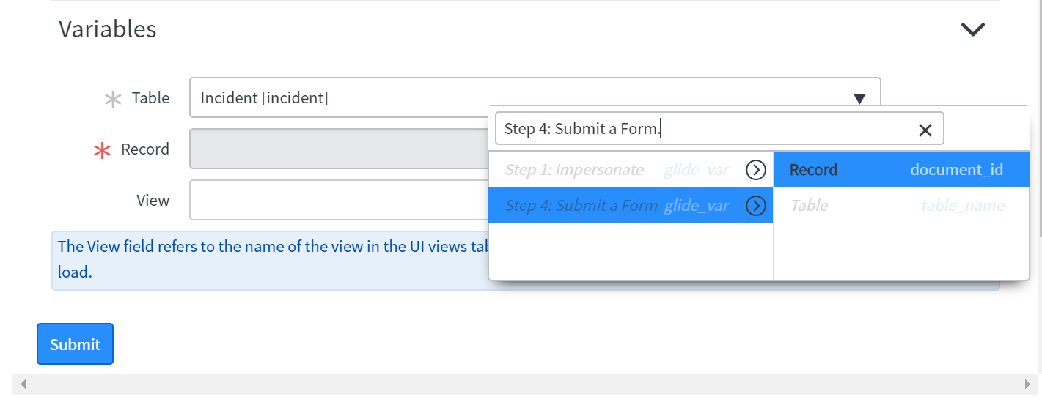

Slide 14
Step 2.09: Click the ‘Add Test Step’ button. Select the ‘Form’ category and select ‘Field State Validation’ (Insert after Step 5). Populate the following and click ‘Submit’:
Table: Incident
Not visible: ATF demo notes
Step 2.10: Click the ‘Add Test Step’ button. Select the ‘Form’ category and select ‘Set Field Values’ (Insert after Step 6). Populate the following and click ‘Submit’:
Short description: Test
Caller: ITIL User
Category: ATF Demo

Slide 15
Step 2.11: Click the ‘Add Test Step’ button. Select the ‘Form’ category and select ‘Field State Validation’ (Insert after Step 7). Populate the following and click ‘Submit’:
Visible: ATF demo notes
Step 2.12: Select the ‘Run Test’ button and confirm that all steps pass successfully.

Slide 16
ATF Lab - Create a Test for IM_003
Step 3.01: Under the ‘Automated Test Framework’ Application select the ‘Test’ module.
Step 3.02: Click the ‘New’ button and create the following Test:
Name: (ATF) IM_003
Description: The 'ATF Demo' button shall only be visible to Users with the 'atf_demo' role.
Step 3.03: Click the ‘Add Test Step’ button. Select the ‘Server’ category and select ‘Impersonate’. Populate the following values and click ‘Submit’:
User: ITIL User

Slide 17
Step 3.04: Click the ‘Add Test Step’ button. Select the ‘Form’ category and select ‘UI Action Visibility’ (Insert after Step 2). Populate the following and click ‘Submit’:
Table: Incident
Not visible: ATF Demo
Step 3.05: Click the ‘Add Test Step’ button. Select the ‘Server’ category and select ‘Impersonate’ (Insert after Step 3). Populate the following values and click ‘Submit’:
User: Auto Test
Step 3.06: Click the ‘Add Test Step’ button. Select the ‘Form’ category and select ‘Open a New Form’ (Insert after Step 4). Populate the following and click ‘Submit’:
Table: Incident

Slide 18
Step 3.07: Click the ‘Add Test Step’ button. Select the ‘Form’ category and select ‘UI Action Visibility’ (Insert after Step 3). Populate the following and click ‘Submit’:
Table: Incident
Visible: ATF Demo
Step 3.08: Select the ‘Run Test’ button and confirm that all steps pass successfully.

Slide 19
ATF Lab - Create a Test for IM_004
Step 4.01: Under the ‘Automated Test Framework’ Application select the ‘Test’ module.
Step 4.02: Click the ‘New’ button and create the following Test:
Name: (ATF) IM_004
Step 4.03: Click the ‘Add Test Step’ button. Select the ‘Server’ category and select ‘Record Query’. Populate the following and click ‘Submit’:
Table: ‘IS’ sys_ui_section
Caption: ‘IS’ ATF Demo

Slide 20
Step 4.04: Click the ‘Add Test Step’ button. Select the ‘Server’ category and select ‘Record Query’. (Insert after step 1) Populate the following and click ‘Submit’:
Table: ‘IS’ sys_ui_element
Element: ‘IS’ u_atf_is_great
Sys UI Section.table ‘IS’ incident
Sys UI Section: ‘IS’ ATF Demo
Step 4.05: Repeat Step 31 but make the following change:
Element: ‘IS’ u_atf_demo_notes
Step 4.06: Select the ‘Run Test’ button and confirm that all steps pass successfully.

Slide 21
ATF Lab - Create a Test for IM_005
Step 5.01: Under the ‘Automated Test Framework’ Application select the ‘Test’ module.
Step 5.02: Click the ‘New’ button and create the following Test:
Name: (ATF) IM_005

Slide 22
Step 5.03: Impersonate User: ITIL User
Step 5.04: Open a new Incident form.
Step 5.05: Set Field Values:
Short description: Test
Caller: Auto Test
Step 5.06: Submit the form.

Slide 23
Step 5.07: Select the custom test config (ATF Demo) Notification Check and populate the following:
Notification: Incident opened for me
Document: Select the record that was created in Step 4 (Use the ‘Cannonball’ icon)
Recipients: auto.test@example.com
Step 5.08: Select the ‘Run Test’ button and confirm that all steps pass successfully.

Slide 24
Create and run the IM Test Suite
Step 5.09: Under the ‘Automated Test Framework’ Application select the ‘Suites’ module and click the ‘New’ button.
Step 5.10: Enter the following and click the ‘Save’ button:
Name: IM Test Suite
Description: ATF Demo
Step 5.11: Under the ‘Test Suite Tests’ related list click the ‘New’ button.
Step 5.12: Repeat the previous step until each of the 5 individual Tests you created are added to the IM Test Suite.

Slide 25
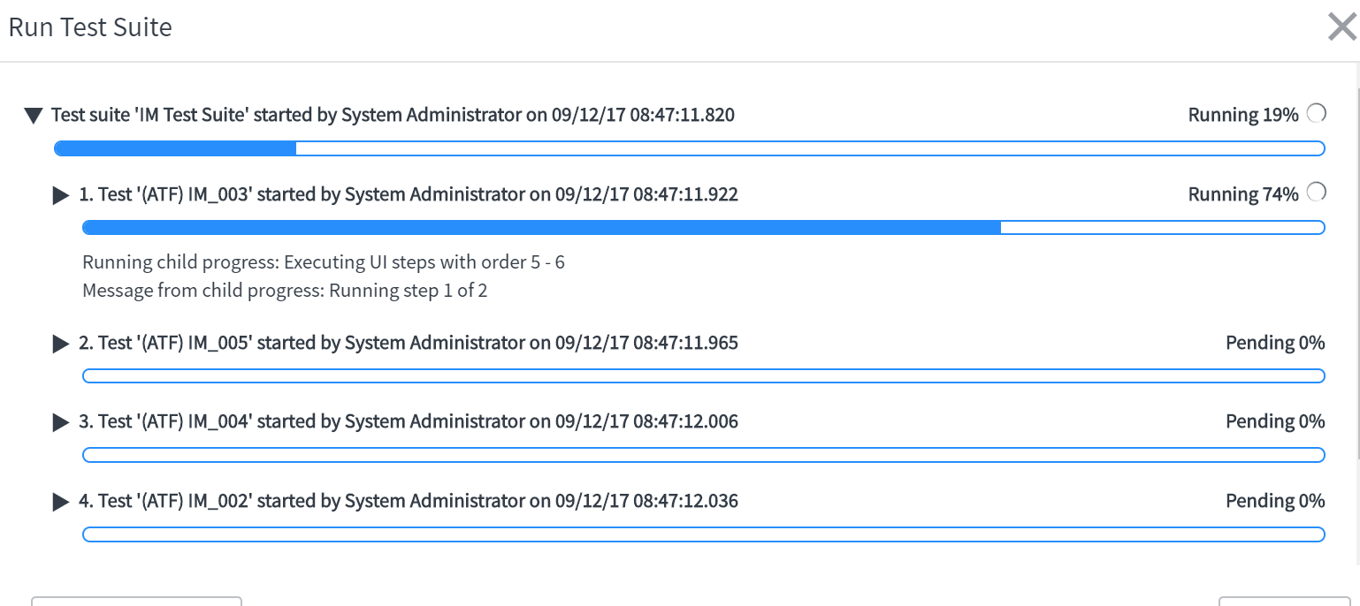
Step 5.13: Select the ‘Run Test Suite’ button and confirm that all Tests pass successfully.

Slide 26
Questions and Discussions

